Slide 1
Art Slide Show
Cierra Garcia

Slide 2
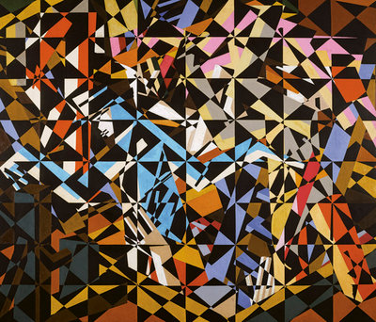
Crystal
Inspiration
“In the Hold” by David Bomberg
Crystal
Acrylic on board
September 2011

Slide 3
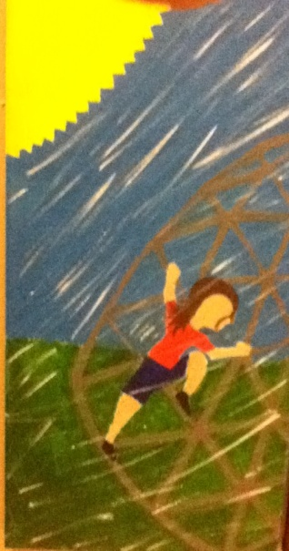
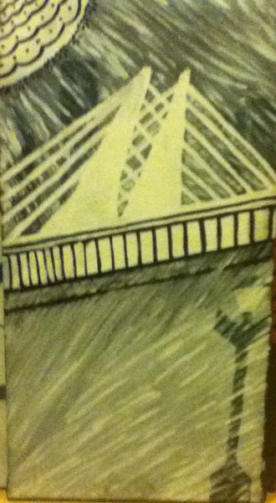
Triptych
Childhood
Acrylic on canvas
November 2011
Inspiration
A picture of myself when I was younger.

Slide 4
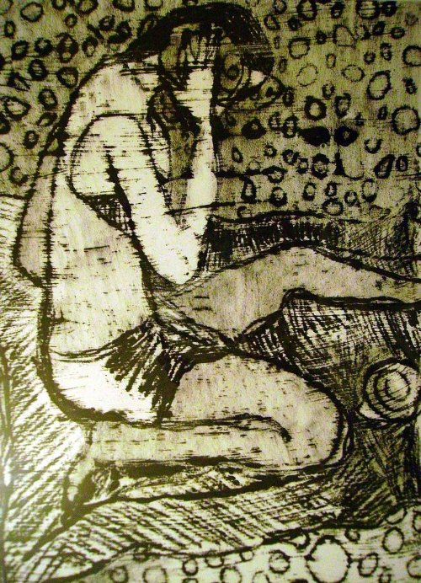
Block-Print
Inspiration
“Monoprint 7” by Ivona Torovin
Block-Print
Ink on paper
November 2011

Slide 5
Monoprint
Mono-Print
Oil on Paper
November 2011
Inspiration
“Monoprint 7” by Ivona Torovin

Slide 6
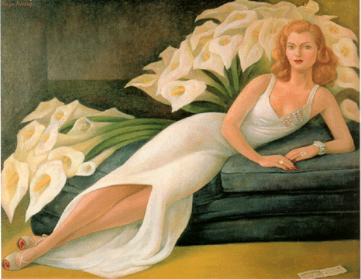
Self-Portrait
Inspiration
“Portrait of Mrs. Natasha Gelman by Diego Rivera
Rivera
Acrylic on canvas
January 2012

Slide 7
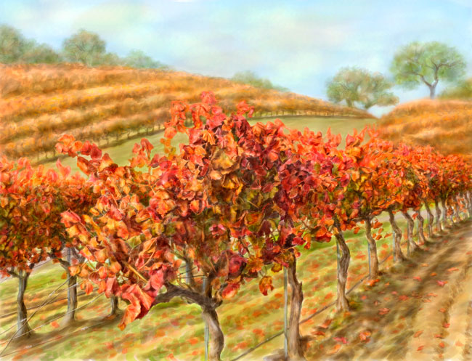
Painting Based on Photography
Nature’s Callin’
Acrylic on canvas
March 2012
Inspiration
“Autumn Leaves” by Nomi Wagner

Slide 8
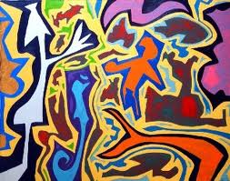
Organic Sculpture
Inspiration
“Modern Art Paintings-Colorful Abstract Art” by Keith Garrow
Tiki Tiki
Plaster
March 2012

Slide 9
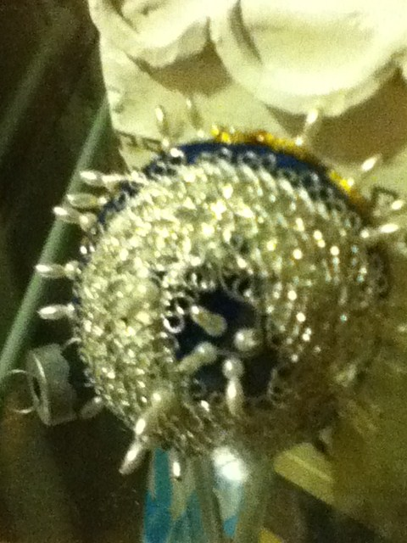
Found Object
Found Object
April 2012
Inspiration
“Found Object Chandeliers” by Stuart Haygarth

Slide 10
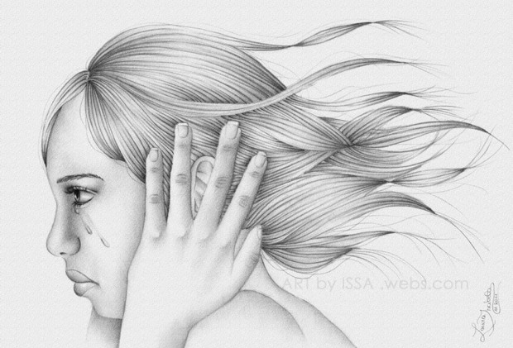
Choice Piece
Inspiration
“Broken Heart Beats” by Issa
In the Wind
Acrylic on canvas
April 2012

